Slide 1
Crafting Multimedia Experiences in the Cloud
[An emerging technology for providing multimedia services and Applications]
Presented By : Manasa Kurapati
23MCA43

Slide 2
Agenda
Abstract
Introduction
Working Of Multimedia
Services Of Multi media, Threads, SecurityMeasures,Issues&Challenges
Conclusion

Slide 3
Abstract
Multimedia uses various forms of media, such as text, audio, video, and graphics, to create a single, integrated presentation. It has become an integral part of our daily lives and is used in various contexts, including education, entertainment, and business. In this article, we will explore the advantages and disadvantages of multimedia and its impact on society.
Multimedia uses multiple forms of media, such as text, audio, video, and images, to communicate information or tell a story. Multimedia has become an important part of modern communication and entertainment, and it is used in a wide range of applications, including the internet, television, film, and video games.

Slide 4
Introduction
Cloud:
The cloud is an extensive network of remote servers around the world. These servers store and manage data, run applications, and deliver content and services like streaming videos, web mail, and office productivity software over the internet.
cloud computing and its benefits:
Cloud computing is the delivery of computing resources, such as IT infrastructure or data center over the internet. This model allows businesses to rent storage space or access software programs from a cloud service provider, instead of building and maintaining their own IT infrastructure or data center.
cloud in simple words: it's a term used to describe a global network of servers, each with a unique function.
cloud computing examples : Emails, calendars, Skype, and WhatsApp are cloud computing examples that we use every single day

Slide 5
Multi media :
Multimedia is a form of communication that uses a combination of different content forms, such as writing, audio, images, animations, or video, into a single interactive presentation, in contrast to traditional mass media, such as printed material or audio recordings, which feature little to no interaction between
Multimedia is a large category of types of resources which can include:
Text and graphics: Slideshow or presentation, diagrams, infographics. Audio: podcasts. Video: screen capture, Lecture Capture, talking head videos, animation, glass screen videos.

Slide 6
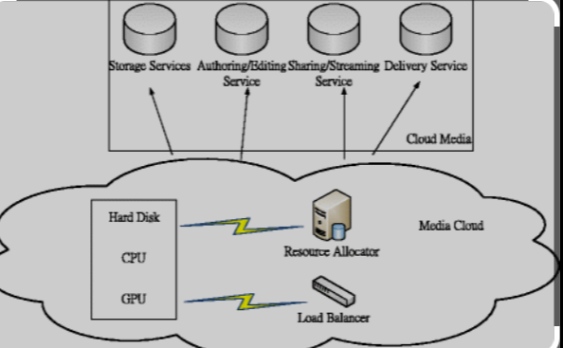
Working of Multi Media
Multimedia specialists design and create IT-based multimedia products such as websites, DVDs, and computer games that combine text with sounds, pictures, graphics, video-clips, virtual reality and digital animation. Relevant experience is desirable, along with familiarity with a range of computer design packages.
Multimedia (MM) refers to applications and technologies that manipulate a stronger and more engaging message than standard text. text, data, images, sound and full-motion-video objects. Given the usage of multiple formats, multimedia is capable of delivering

Slide 7
Services of Multi media:
A multimedia service is a combination of two or more media components such as voice, data, video, and still image, in a single session delivered between two or more parties. Multimedia services can be classified as interactive or distribution services. User interaction defines the behavior of interactive services.
Multimedia communication deals with the transfer, protocols, services, and mechanisms of discrete media data (such as text and graphics) and continuous media data (like audio and video) in/over digital networks.
ITS Multimedia Services provides Cal State LA faculty and staff with multimedia production and instructional technology support. Available services include:
1) Production of instructional, training, and promotional media for digital and web distribution.
2) Motion graphics design and animation.
3) Post-production services, including audio and video editing, video format conversions, and media preparation for web distribution.
4) Pre-production, production, and post-production consultation.
5) Instructional video technology consultation.
6) Closed captioning.

Slide 8
Threats :
IT risks include hardware and software failure, human error, spam, viruses and malicious attacks, as well as natural disasters such as fires, cyclones or floods. By looking at how your business uses IT, you can: understand and identify the types of IT risks. understand the impact of risks on your business.
7 Common Internet Security Threats You Need to Know About
Malware: Malware is a type of software designed to damage, disrupt, or gain unauthorized access to a computer system. ...
Phishing: attempt to steal sensitive information, typically in the form of usernames, passwords, credit card numbers, bank account information or other important data in order to utilize or sell the stolen information.
Social Engineering: an attacker uses human emotion (usually fear and urgency) to trick the target into performing an action
Password Attacks: any attempt to exploit a vulnerability in user authorization within a digital system
Denial-of-Service Attacks: A type of cyber attack in which a malicious actor aims to render a computer or other device unavailable to its intended users by interrupting the device's normal functioning.
Man-in-the-Middle Attacks: A man-in-the-middle attack is a cyberattack in which the attacker can secretly intercept messages between two or more parties who believe they are communicating with each other.
FAQs etc.

Slide 9
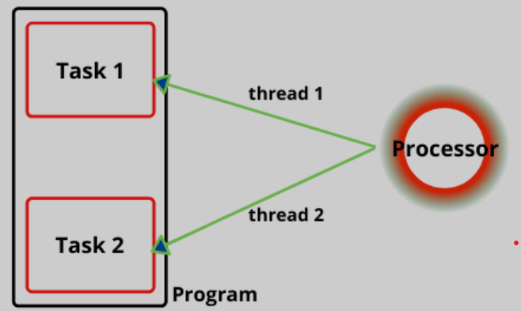
Image of threads of multi media

Slide 10
Security Measures:
Multimedia security addresses the problems of digital watermarking, data encryption, multimedia authentication, digital rights management, etc.
Understanding Multimedia Security : increased requirement for security, due to various threats which includes replication of digital data without any information loss, and manipulations of the same without any detection.
Evaluation Metrics Used for Image Encryption to Analyze the Efficiency Towards Various Attacks: The metrics are encryption/decryption time, throughput, power consumption, memory consumption, simulation time.
Machine Learning Approaches to Malware Detection Systems : Machine learning algorithms analyze the extracted strings from files to learn patterns and features that distinguish between benign and malicious strings.
Securing Identities Through Biometric Template Security: Authentication. Biometrics are commonly used to authenticate a person's identity. Some examples of this include fingerprint or facial recognition to access smart phones, or the use of facial recognition technology at airport smart gates.

Slide 11
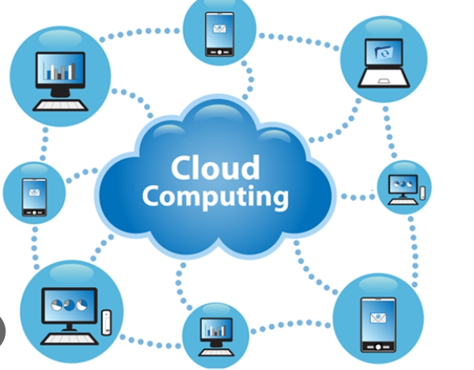
A Future Cybersecurity for Secured Smart Home Applications Using the Internet of Things and Blockchain Technology:
The model employs multivariate correlation analysis and the detection of correlations between traffic functions.
Watermarking and Copyright Protection of Remotely Sensed Images:
embeds a known message in a piece of digital data as a means of identifying the rightful owner of the data.
Evaluation of Pan sharpening Techniques for Multimedia Image Enhancement:
a simple algorithm designed to optimize visual contrast at both ends of the satellite imagery's histogram.

Slide 12
Issues & Challenges
They found, “the challenges include electrical resources, networking, application software systems, human resources, hardware system, and risk management.
Host computing power requirement: :computer or other device that communicates with other hosts on a network. Also known as network hosts, hosts include clients and servers that send or receive data, services and applications.
Data storage and management requirements: Data storage management refers to the process of managing data more effectively. It requires a proper understanding of storage devices and the availability of various types of data.
Human interface usability requirements: ensures system the system is efficient, effective, safe, easy to learn, easy to remember, easy to evaluate, and provides job satisfaction to users.
Network latency and throughput requirements: Throughput measures the volume of data that passes through a network in a given period.

Slide 13
Applications of Multimedia :
Allow for the same content to be presented in different ways. Having a combination of text, images, and sound can help emphasize your message and catch people&amp;apos;s attention at multiple points during the presentation.
Creative Industries
The art of integrating multiple forms of media.(used in video games, websites and many other interactive applications)
Commerce
It includes graphics, animation, sound and video.is becoming a key technology for e – commerce: digital video.
Interior Designing
Animations allow designers to showcase the construction processand demonstrate how spaces come together.
Deals with the transfer, protocols, services, and mechanisms of discrete media data(such as text and graphics)
Social Work Purposes
Communication

Slide 14
The benefits of using multimedia :
Enhancing website aesthetics.
Boosting website traffic and SEO.
Better storytelling capabilities.
Easier explanation of complex ideas.
Increased shareability and social media reach.
Better storytelling capabilities
Easier explanation of complex ideas.

Slide 15
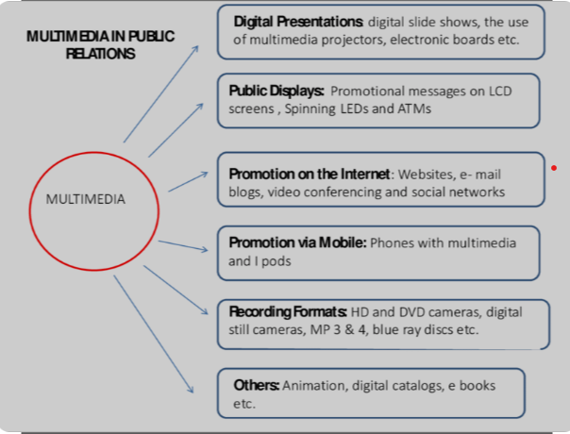

Slide 16

Features of Multimedia: Multimedia has many features that make it an effective and engaging medium for communication and entertainment. Here are some common features of multimedia:
Text
Video
Interactivity
Images
Accessibility
Adaptability

Slide 17
Conclusion:
The use of multimedia material and these should be considered to ensure that best practice procedure is followed. These principles may be coupled with the instructor and student requirements to determine a set of design goals to refer to before proceeding with the introduction of multimedia material into the training environment.
Overall, multimedia features make it a powerful and effective tool for communication and entertainment. It allows for the creation of engaging and immersive experiences that can be tailored to a wide range of audiences and platforms

Slide 18

Thank you
Manasa Kurapati
manasakurapati12@gmail.com

